Slide 1
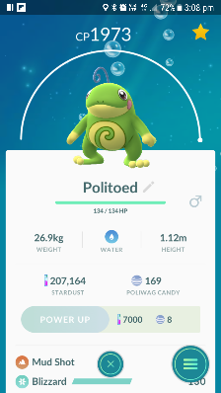
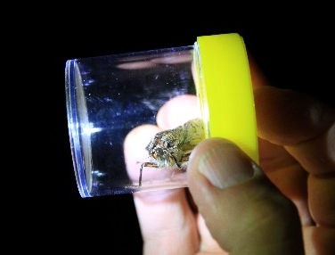
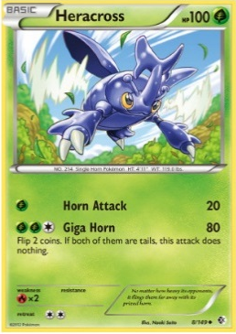
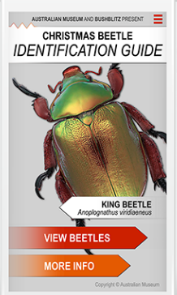
Pokémon are based on real plants and animals
Databases record what is found
Taxonomy
in real life
Taxonomists collect specimens too!
Apps can help with identification
This activity was developed by

